Slide 1
Utilizing Science & Technology and
Innovation for Development
Alzheimer’s Nutrition Assistant and
Alert System
Marriott Hotel- Amman, August 12th, 2015

Slide 2
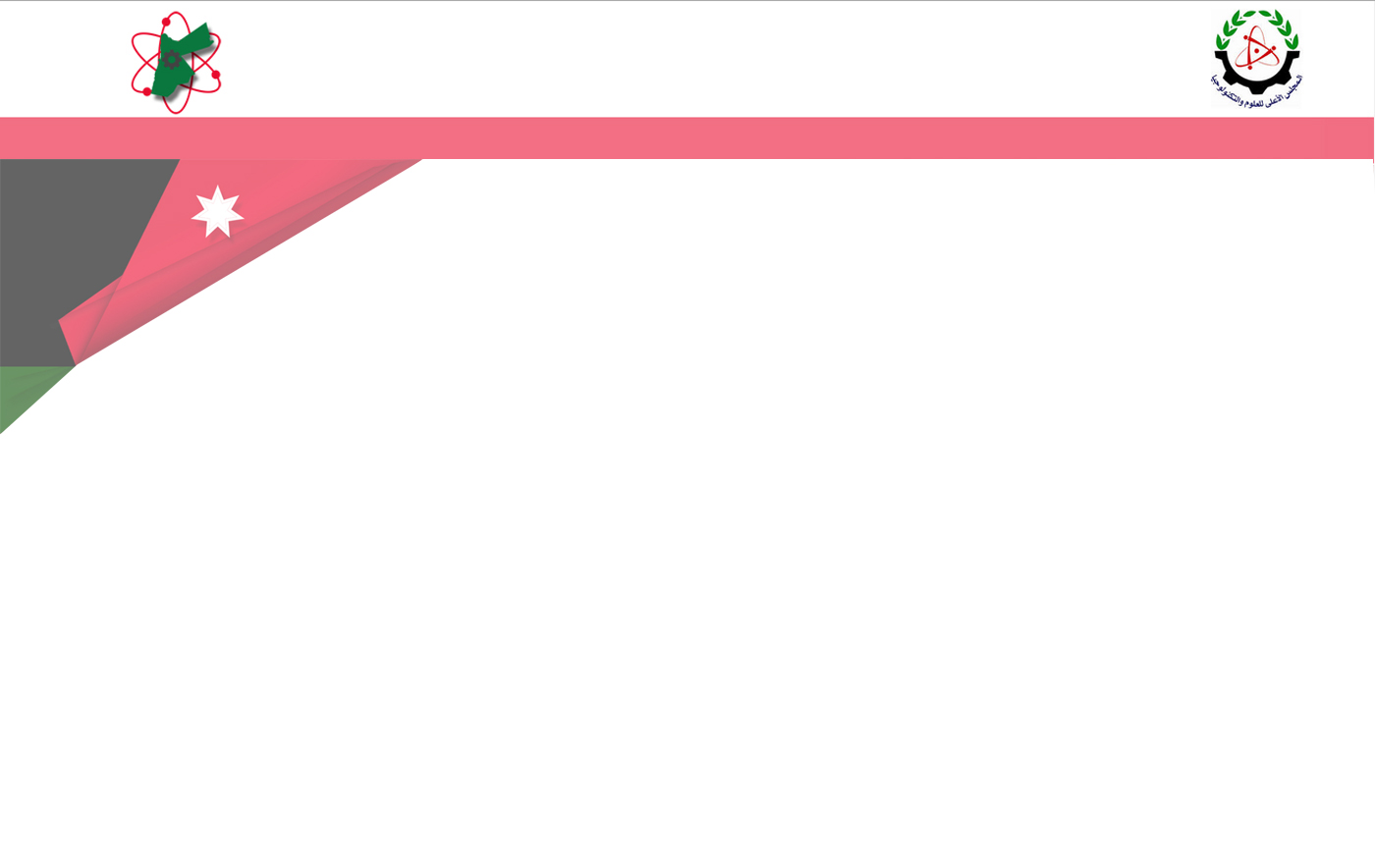
Project Team
Dr. Emad Awada
Assistant Professor of Electrical Engineering
Applied Science Private University,
Amman, Jordan
Dr. Ikhlas Abdel-Qader, PE
Professor of Electrical and Computer Engineering
Western Michigan University,
Kalamazoo, Michigan, USA

Slide 3
Brief Description
Alzheimer’s Nutrition Assistant and Alert System
Nutrition Assistant and Alert System is a project aimed at developing a prototype of a device that enables monitoring and prompting patients with reduced cognitive abilities such as in Alzheimer’s and Dementia patients.
The device is an embedded system developed using Digital Signal and Image Processing techniques to enable the extraction of required signature features from captured video images and audio signals.
The hybrid classification techniques will allow for a decision to be declared on the status of the ongoing eating process if any and alert the caregiver if the patient is not eating, or done eating.
The SW and HW together will bring on a device that can enhance daily lives for millions in the business of caregiving of patients or loved ones.

Slide 4
Justifications
Feeding is a serious problem for people who are suffering from Dementia or Alzheimer’s diseases.
When a loved one loses his cognitive abilities due to Dementia and Alzheimer, a nursing aid or caregiver will have to continuously monitor the patients and periodically reminding them to eat or do feed the patient themselves.
Individual patient monitoring and prompting require a considerable amount of time and attention, severely limiting the caregiver’s ability to perform other tasks or deal with multiple patients in a nursing home.
The cognitive impairment found in persons with Dementia often prevents the older adult from accepting help with feeding from caregivers.
Similarly, for patients who live at home, this device will ease the burden on their loved ones since they have to go to work and live their daily lives without worrying if their elder has eaten the food they placed in front of them.
Notes:
These diseases mainly affect older adults who literally forget to eat even when food is in front of them as they lose their basic cognitive abilities.

Slide 5
Objectives
We are proposing to develop a system that will use various sensors to monitor a patient, to determine if and when food is eaten, and swallowed, and when it is necessary to provide both audio and video prompting. In addition, coaching to guide the patient to continue or even to start eating as needed. Currently there is no such device or technology that addresses this need while the need for it is growing rapidly.
This system can also be used for people with other eating disorders such as obese people who need to watch their food intake. Such a system can be a private monitor to remind them of things such as eating slowly or to stop based on ongoing events.
Notes:
The proposed system can be easily modified to provide prompting, coaching, and queued messages of encouragement or positive feedback for a range of additional applications.
This system will alert the caregiver of the patient not eating if times passes without activity

Slide 6
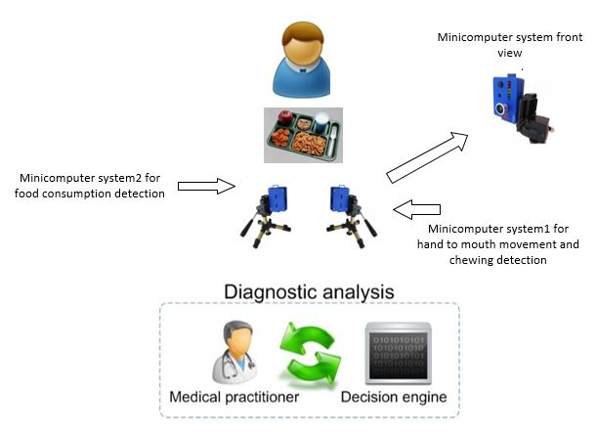
Scope of work, Duration, and
Estimated Budget
Patient
Scope of work:
This work aims to develop a prototype of biomedical engineering device to monitor, prompt, and alert the activity of Alzheimer’s patients (particularly eating).
Duration: 2 years
Estimated Budget : 100k JD

Slide 7
Methodology of Implementation
The system will be composed of multiple sensors and software modules to be infused in one embedded system as follows:
1) Data Acquisition Phase:
Captured videos will be transmitted to a microcontroller, and using written code, we will extract the features and clues on the activity of the patients.
The algorithms will allow for tracking such activities and extracting those aimed for features such as:
the hand movement between the tray and mouth,
food consumption on the serving tray, and
mouth movement cues extracted from jaw movement while eating.
Chewing sound will also be utilized in this system using a sound sensor.
2) Data Processing Phase:
Using several image processing techniques including preprocessing, filtering, feature extraction, feature matching among video frames, and machine learning techniques.

Slide 8
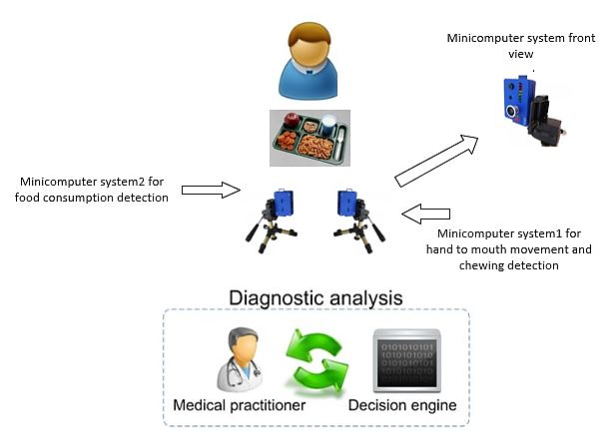
Methodology of Implementation
3) Outcomes will be wirelessly transmitted using Wi-Fi network for charting and record keeping and/or for alerting caregiver.
Patient
4) The system can be also easily modified to communicate with earpiece or mobile texting for individuals with eating disorder suffering from obesity or other food related disorder.

Slide 9
Expected Output
An Alzheimer Nutrition System Prototype will be developed.
Hardware and software implementation using Digital Signal and Image Processing techniques will enable the device to extract required features from captured video (images and audio signals), and using a hybrid classification technique will be implemented.
Patent application will be submitted.
Work will also be published with full acknowledgment to JoSTA.
Other sponsors/investors will be sought.

Slide 10
Impact
The proposed device will be the first aimed to aid with the care of Alzheimer’s and other Dementia patients. This will positively impact millions of lives.
Worldwide- nearly 44 million people have Alzheimer’s or a related Dementia. (Alzheimer’s Disease International)
Alzheimer’s and other dementia disease s are the top cause for disabilities later in life. (Alzheimer’s Disease International)
http://www.alzheimers.net/resources/alzheimers-statistics/
Feeding difficulty is often recognized as a common problem for older adults and is associated with weight loss, poor nutrition, and risk for aspiration pneumonia.
The proposed device can also be used for patients with eating disorders. Leading to significant product development and economic growth.

Slide 11
Sustainability
The prototype has strong potential for commercialization which will also lead to economic development.
In addition, this particular study and innovation can be expanded to other applications in the Biomedical Engineering Field.

Slide 12
Action Plan
The prototype will be built in two years into two systems, each has SW and HW components as follows:
1) Vision sensors, Data collection and Fusion: Sensors will be used to track and extract the specific signature information needed for the detection. September 2015- May 2016.
2) Processors. September 2015-May 2016.
A. System 1, using a tablet. This one will be cheaper and simpler to use.
B. System 2 will be based on the Raspberry Pi 2 microcontroller. This one will have
more capabilities and allow customer to edit and adapt.
3) Testing in real life on patients in nursing homes. May 2016-July 2017.
4) Submitting a patent application. May 2016.
5) Patient/User Friendly Features. October 2016- January 2017. Several add on features
will be implemented too.
6) Publishing, and project reporting and submission to funding agency January 2017-
July 2017.
Notes:
For number 5) These include but not limited to: a) Allow loved ones to record their voice and images talking to the patient about food intake or not, or simply to chat with them, b) allow caregiver to input types and quantities of food, allow device to generate and record an estimate of consumption.
Tablet is cheaper because they have it, they buy on their own.

