Slide 1

Utilizing Science & Technology and Innovation for Development
High Data Rate Wireless Communication System Through Light
Marriott Hotel- Amman, August 12th, 2015

Slide 2

Project Team
Dr. Mohammed Aloqlah/Yarmouk University/Jordan
Dr. Raed Mesleh/University of Tabuk/Saudi Arabia
Dr. Osamah Badarneh/University of Tabuk/Saudi Arabia

Slide 3
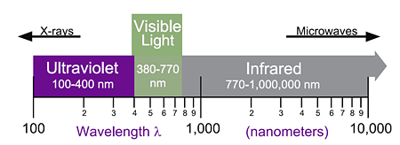
Brief Description
OWC: Wireless (unguided) transmission through the deployment of optical frequencies
  Infrared (IR)
  Visible (VL)
  Ultraviolet (UV)
Intensity Modulation/Direct Detection (IM/DD)
Amplitude constraints
  Non-negativity of the signal
  Eye-safety regulations

Slide 4

Justifications
  Large bandwidth capacity
  High degree of spatial confinement
    High reuse factor
    Inherent security
    Lower power requirements
    Robustness to EMI
    Unregulated spectrum
    Easy-to-install and re-deployable

Slide 5
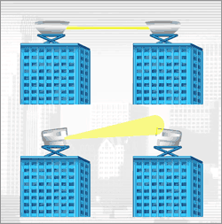
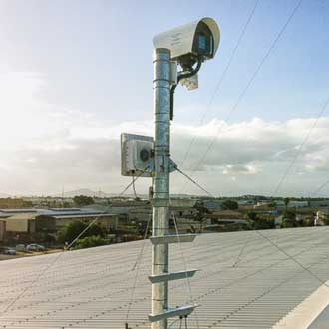
Objectives
Develop and commercialize an efficient wireless communication system through light
Enable high outdoor data rate transmission in the range of 1–10 Gbps over 2–30 Km distance
Developed system will enable:
  Building-to-building connections
  Easy to install and re-deployable
  Fiber-optic/microwave alternative

Slide 6

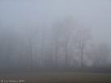

Scope of work
The impacts of weather conditions in Jordan on the performance of the system will be studied and analyzed
Propose new techniques to overcome harsh weather conditions
RAIN
The atmosphere behaves like prism
of different sizes and refractive indices
FOG
Phase and irradiance fluctuation
TURBULENCE

Slide 7
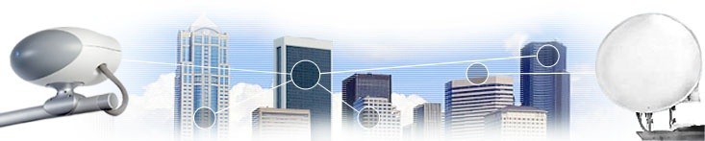
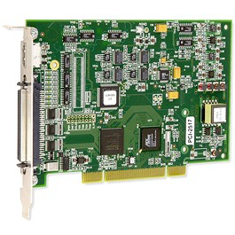

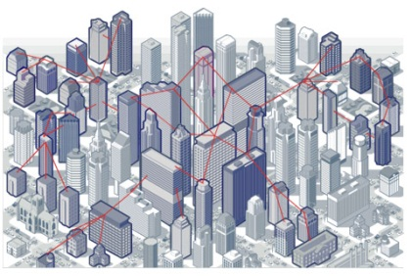
Methodology of Implementation
Study yearly weather conditions in Jordan
Analyze the impact of different weather conditions
Propose solutions to mitigate different weather conditions such as:
  Multi-hop
  Diversity
  WDM
  Hybrid RF/OW system
Design Hardware system
Implement the system and conduct measurements

Slide 8
Duration & Budget
Duration: 2 years
HW Cost: JD 150,000.00
Salaries: JD 50,000.00
Travel: JD 10,000.00
Consumables: JD 3,000.00
Total requested Budget : JD 213,000.00

Slide 9
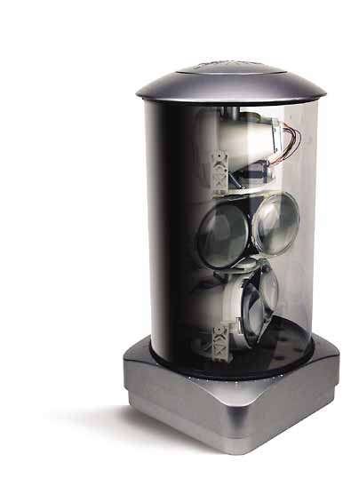
Expected output
Low-cost & high data rate wireless communication system
Design to achieve optimum performance in Jordan environment
Novel hardware and software algorithms will be developed
Contribution to fundamental research and applied research
Patents, technical papers, hardware prototype and software algorithms are anticipated

Slide 10


Impact
License-free (No spectrum cost)
Cheap components
No health concern (eye and skin safety regulations)
No interference with RF (suitable for military sensitive areas)
System components can be manufactured locally and commercialized abroad
Green energy (low carbon emission)
High security wireless systems (No eavesdropping)

Slide 11
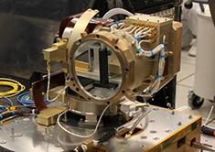
Sustainability
Reliable design
Maintain optimum operating environment for the selected components and sub-systems
An environmentally—sealed with appropriate heating and cooling mechanisms
Impact of varying components parameters should be considered in the design process
Active cooling for system components to further enhance the lifespan
An impressive mean time before failure shall be targeted

Slide 12
Action Plan

Slide 13
Thank you for your attentions!

